Slide 1
Malware Detection using ML and Python
TEAM MEMBERS:
RAMYA MIHIR(500067119)
ISHA MITTAL(500068884)
Under Guidance of our Mentor: J. Dhiviya Rose

Slide 2
Problem Statement
This project is related to Cyber Security Domain, where we will check whether the file is malicious or not.
Problems in today’s world:
Unaware of the cyber crimes
Lack of awareness
Providing permisiions without knowledge
The project will be in Python language with the usage of Machine Learning Models.

Slide 3
Proposed Methodology
With this project, we propose a new approach to identify malwares using static analysis, i.e. without executing. With the help of different machine learning models, we will identify malwares and analyses the performance of different models for the same.
The programming language we are using is Python so we will work on what are the system requirements, libraries requirement, and compiler/ID requirements for conducting our project successfully.

Slide 4
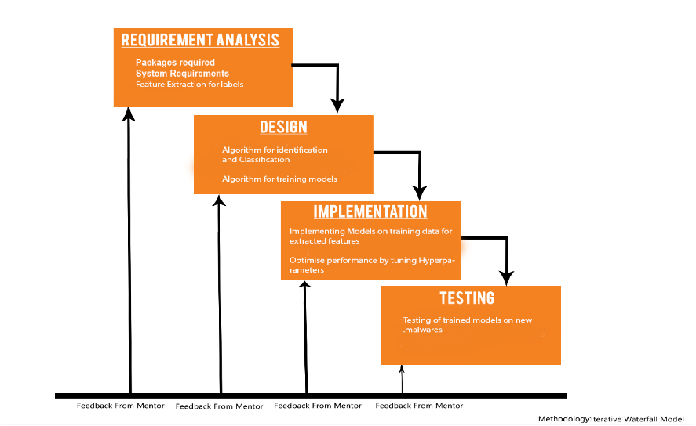
This is the model, which we will apply to solve the problem and hence thereby find and identify the malware present in a file, and thus, declare it a malicious file.

Slide 5
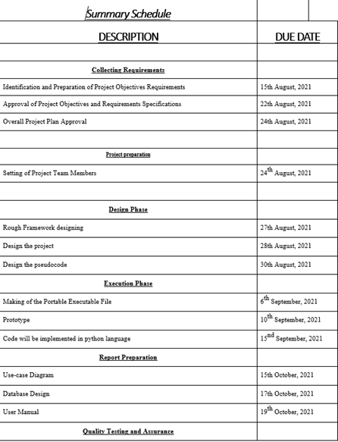
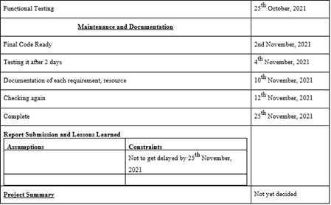
Pert Chart

Slide 6
REFERENCES
https://media.kaspersky.com/en/enterprise-security/Kaspersky-Lab-Whitepaper-Machine-Learning.pdf
https://www.ccsinet.com/blog/machine-learning-malware-analysis/
https://www.imperva.com/learn/application-security/malware-detection-and-removal/

Slide 7
THANK YOU

